Slide 1
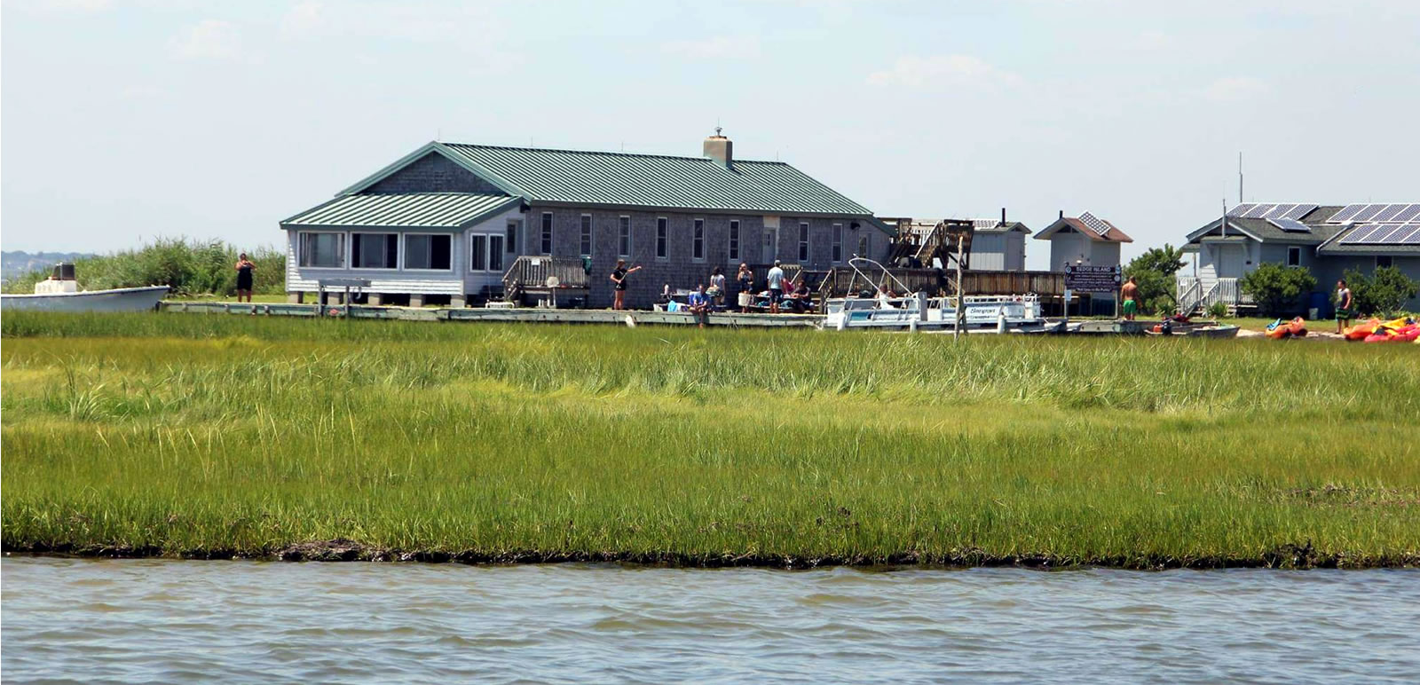
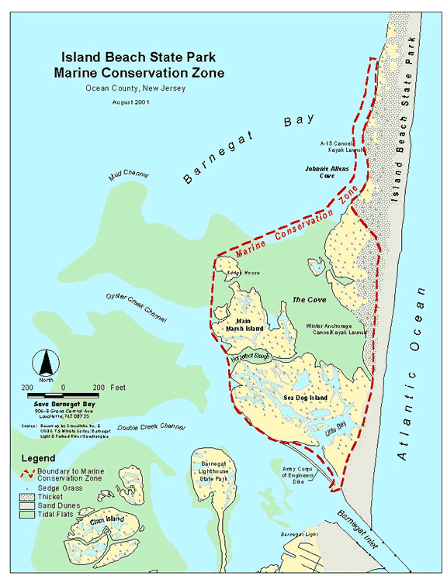

Slide 2
Sedge Island Field Trips
Fill out and return the permission forms
Check into homeroom and leave from school via fieldbus at 7:45am
Return after dismissal to either:
  Toms River OCVTS - 3:30pm
  MATES - 4:00pm
Groups of 16-18 students
Teachers: Jason Kelsey, Amy Williams, Juliana Perello
Each student will be assigned 1 of the six dates to attend:
  Sept 14, Sept 15, Sept 16, Sept 18, Sept 22, or Sept 25

Slide 3
Sedge Island Packing List
sunscreen & insect repellent (non-aerosol)
refillable water bottle
sunglasses w/ lanyard
hat w/ brim
water shoes - old sneakers or sandals with strap (something that won’t get pulled off of your feet in the mud)
extra pair of shoes (flipflops or crocs are ok)
long lightweight pants and shirt
bathing suit, towel (we will have wet and dry activities)
raincoat or wind breaker (NOT a poncho)
change of clothes
bag lunch and snacks

Slide 4
Sedge Island Activities
Goal: Learn about Barnegat Bay ecology and conservation through hands-on Education
boat ride
kayaking
clamming
birding
nature walks
seining
All activities subject to weather conditions and may change as needed

Slide 5
Questions?
More specifics will be provided during the Marine Biology Class
Jason Kelsey - MATES Science Instructor/Research Advisor; jkelsey@ocvts.org
Amy Williams - MATES Science Instructor/Research Advisor; amywilliams@ocvts.org
Juliana Perello - MATES Marine Biology Instructor; jperello@ocvts.org

