Slide 1
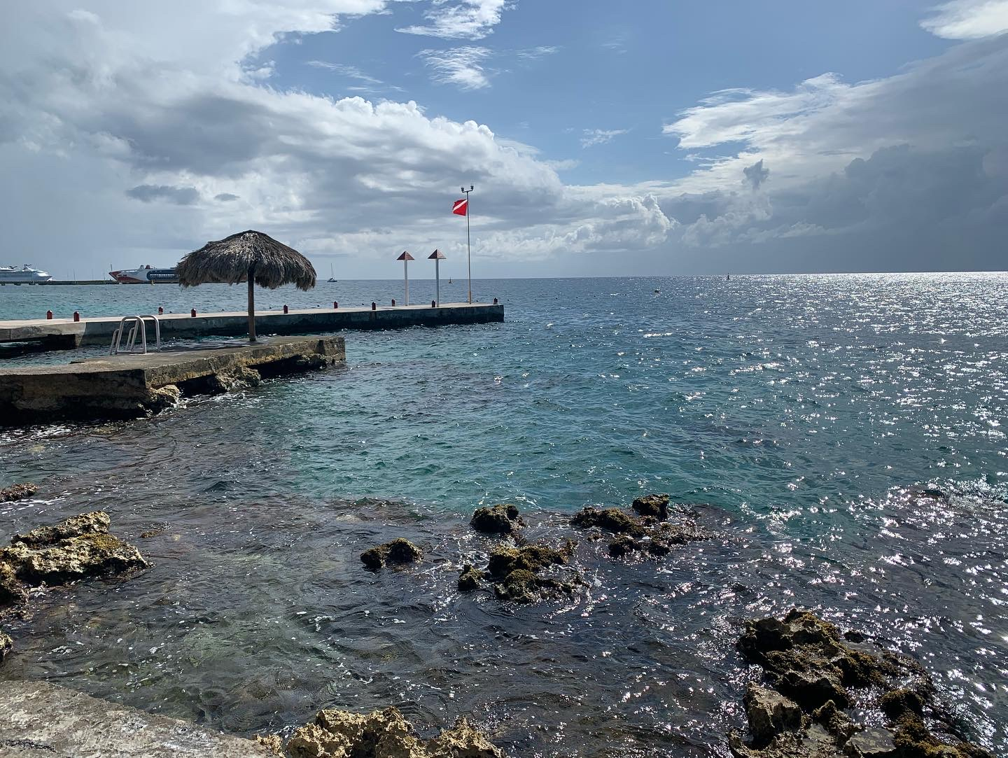
Welcome to Freshman Biology (aka Marine Bio)

Slide 2
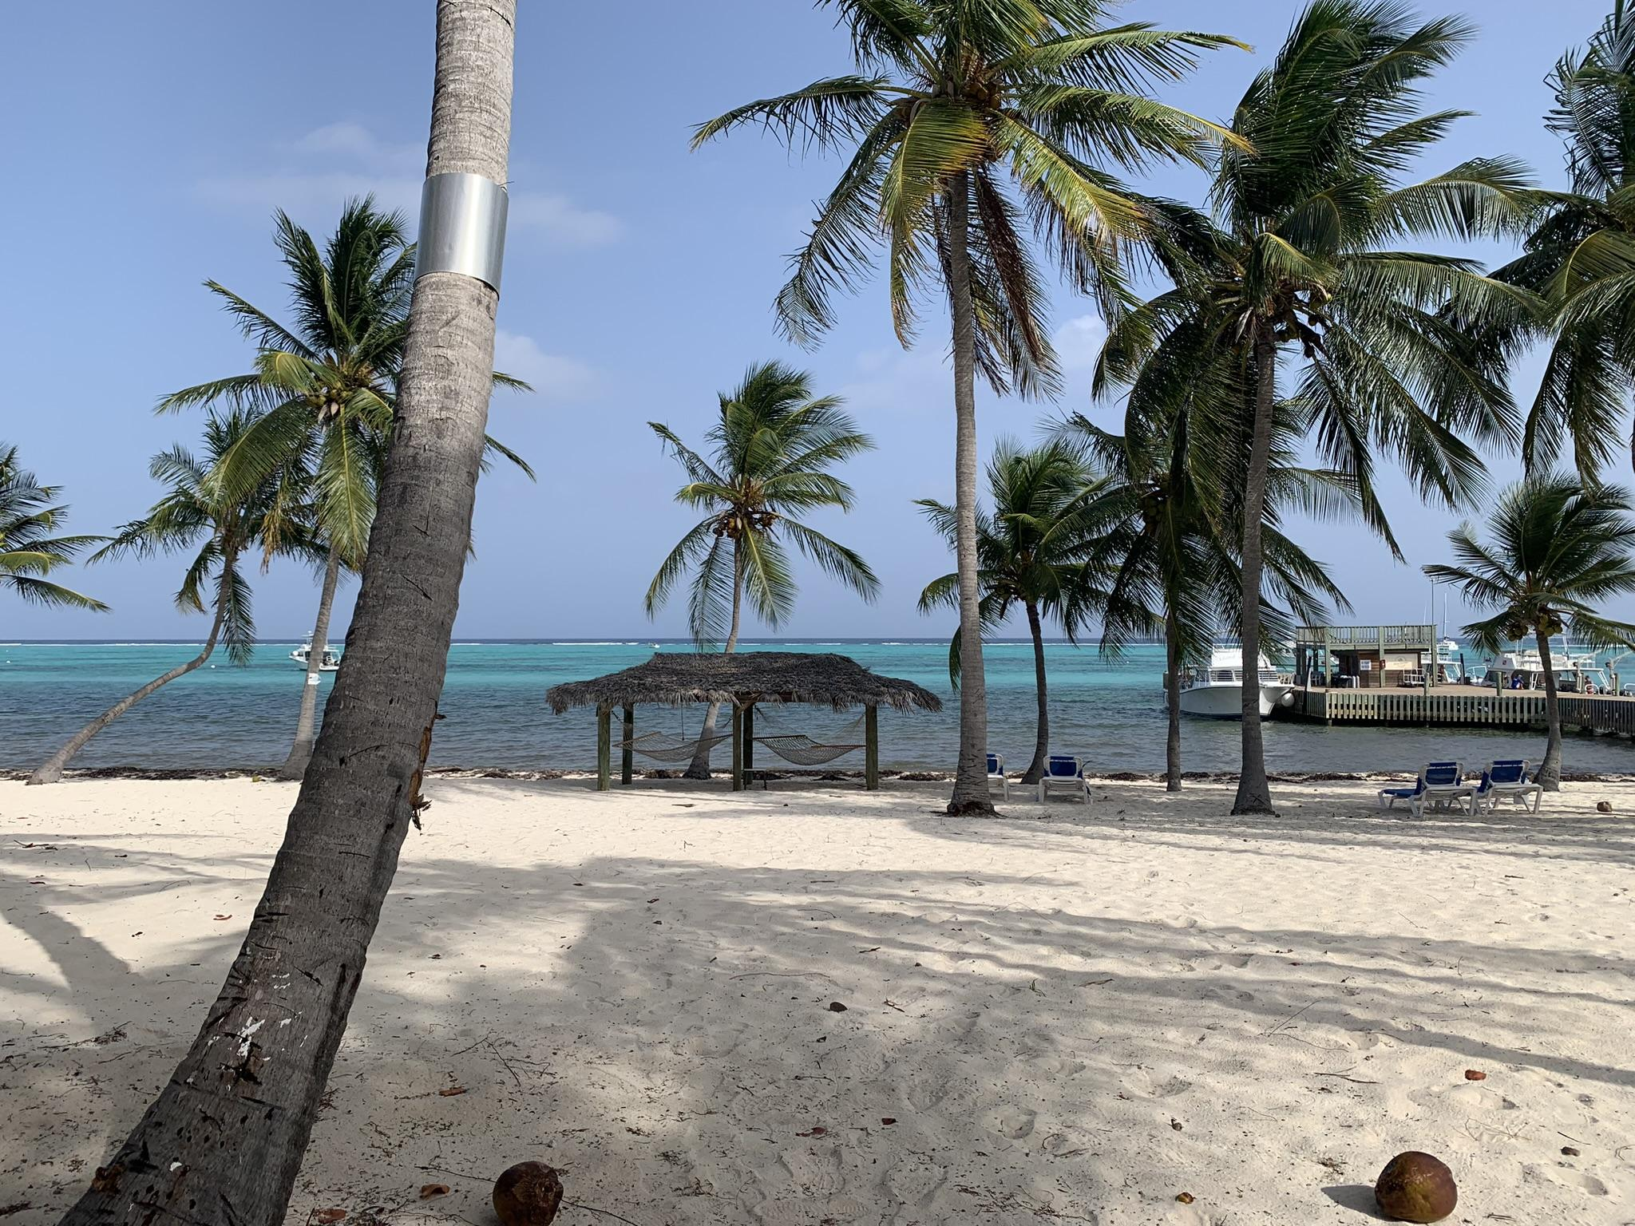
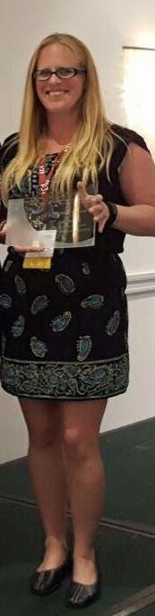
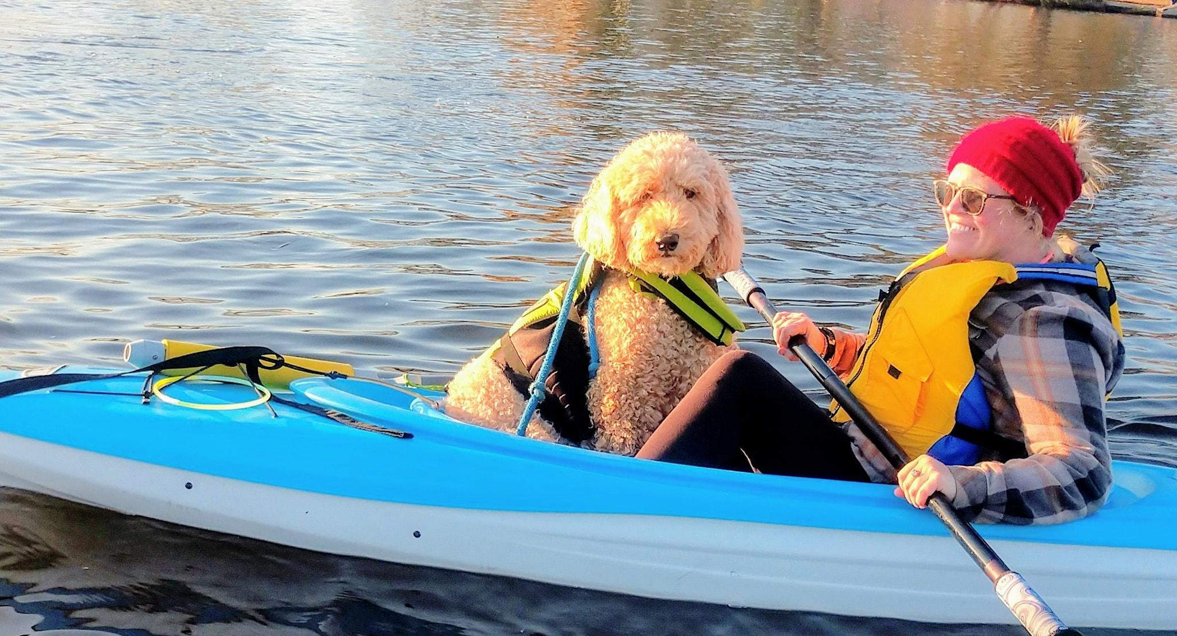
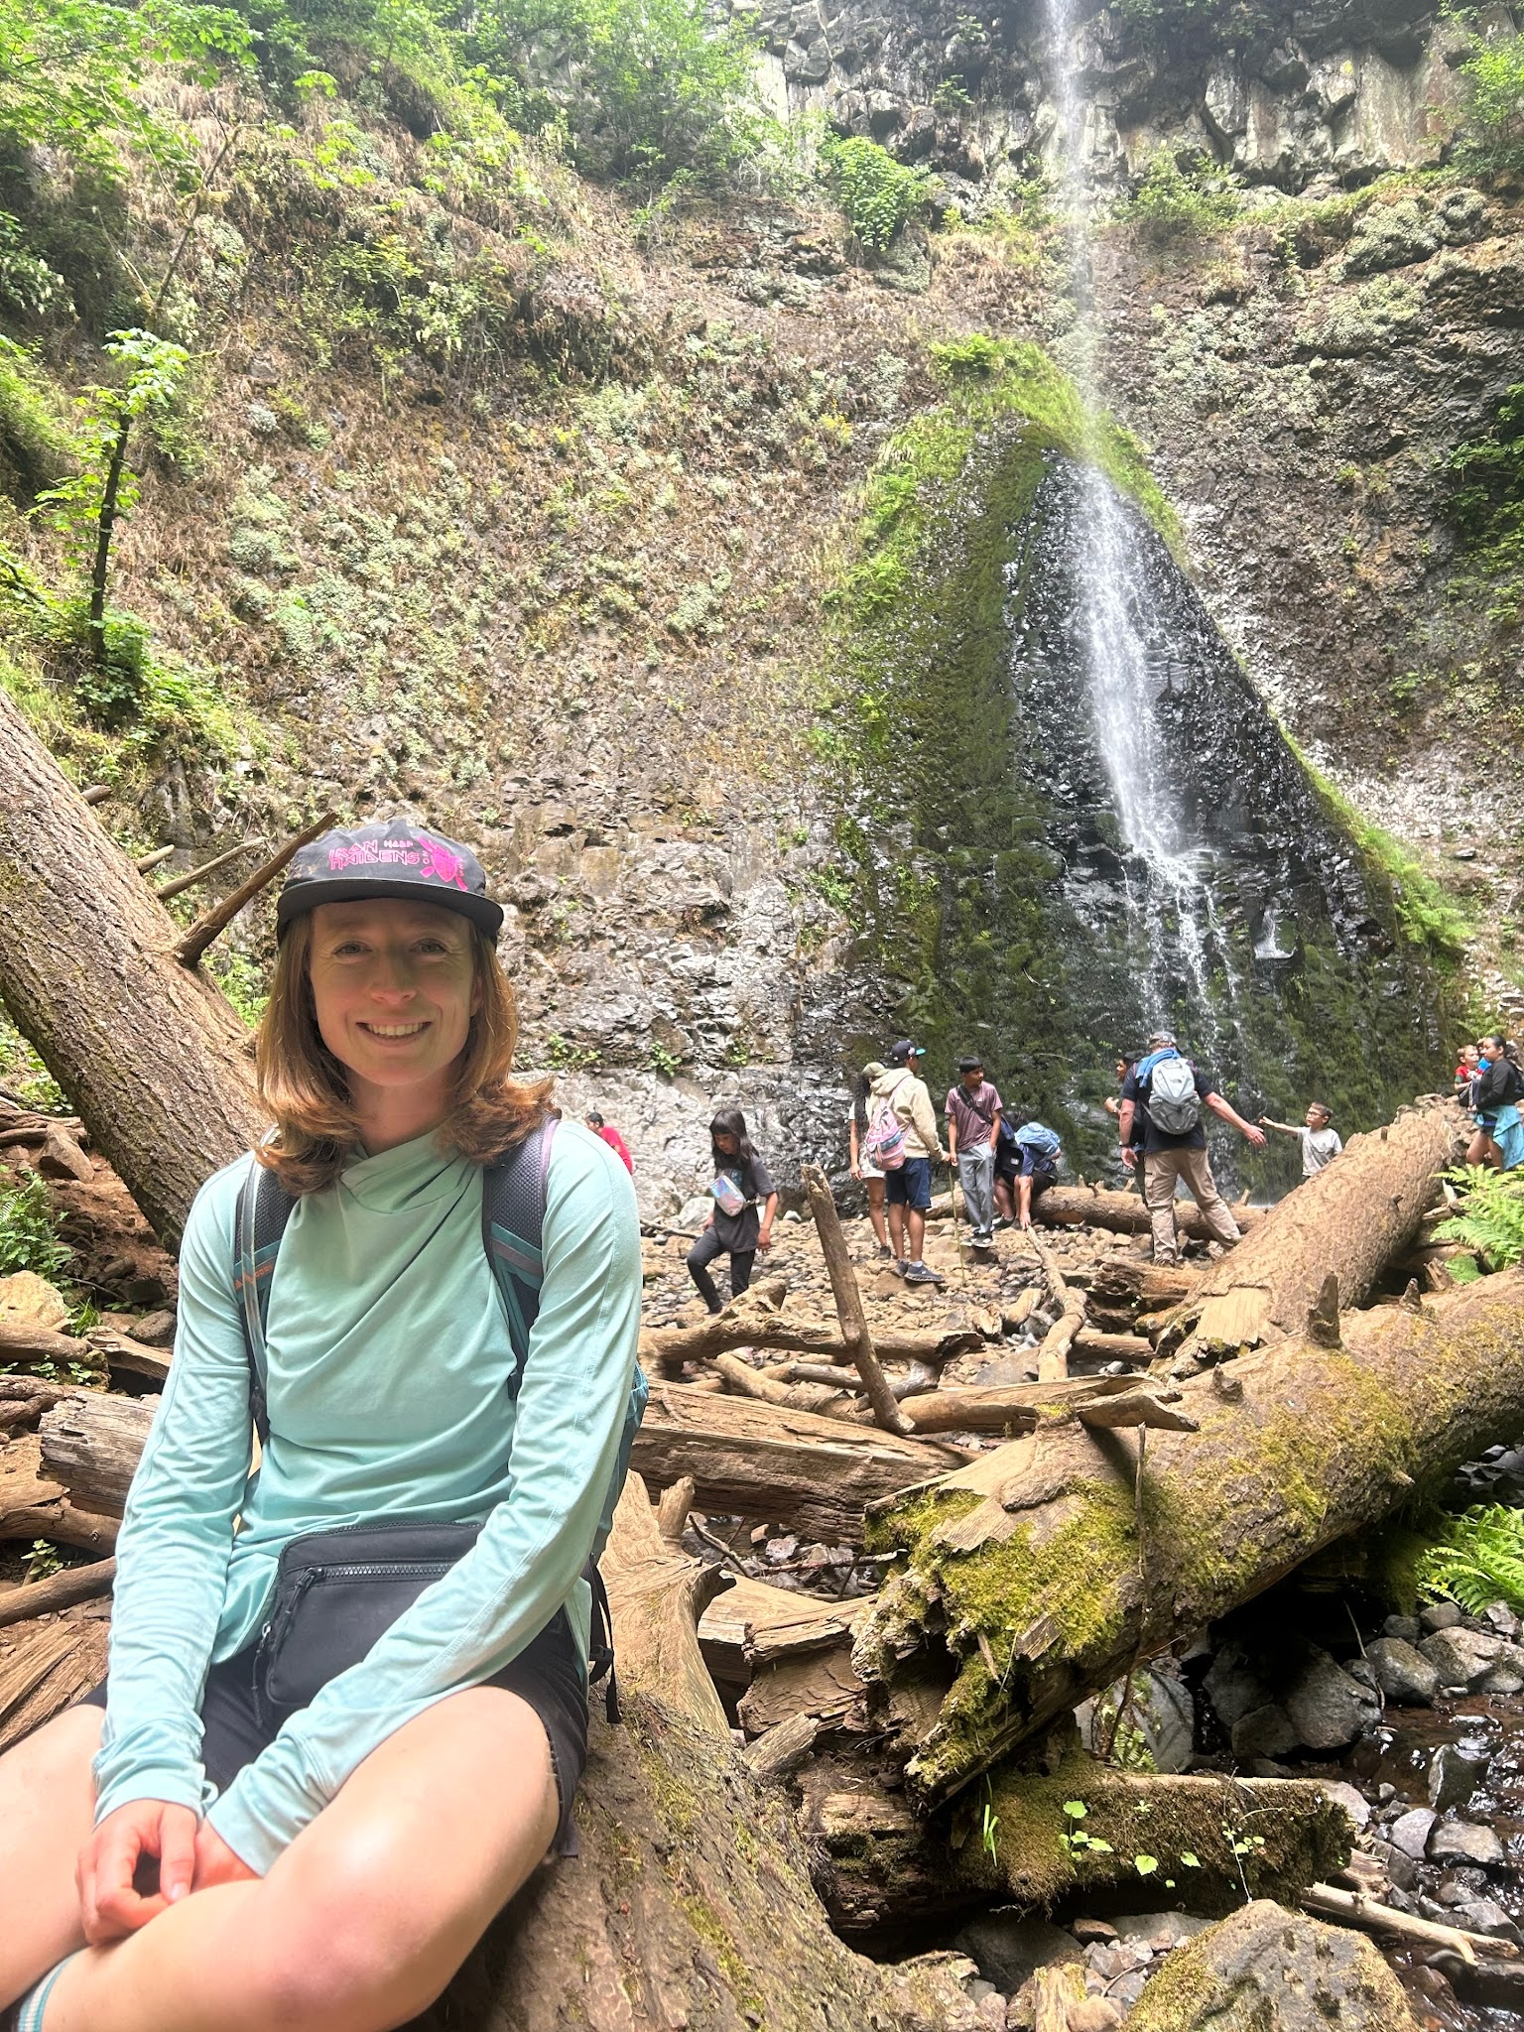
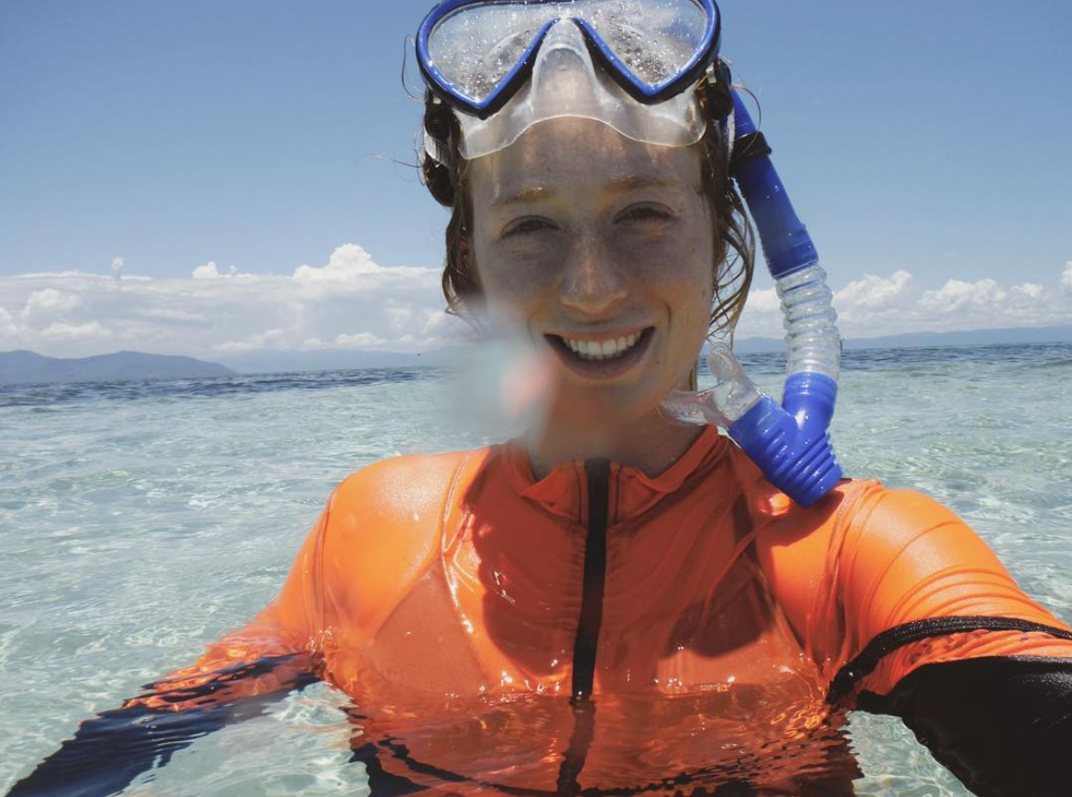
Dr. Amy Williams
Office /Classroom - Room 151
Email - amywilliams@ocvts.org
Ms. Juliana Perello
Office - Room 151
Email - jperello@ocvts.org

Slide 3
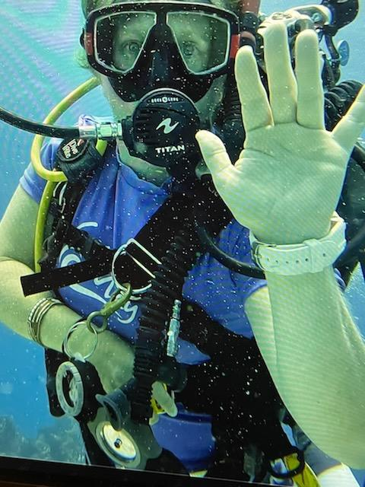
Course Topics (order is subject to change):
Taxonomy
Plankton/Microbial World
Multicellular Algae
Invertebrates
  Porifera, Cnidaria, Ctenophora, Platyhelminthese, Nemertea, Rotifera, Nematoda, Mollusca, Annelida, Arthropoda, Echinodermata,
Vertebrates
  Marine Fishes (Chordata, Cartilaginous, Bony)
Evolution and Natural Selection
Marine Mammals
  Cetacea, Sirenia, Pinnepedia, Carnivora
Reptiles
  Snakes and Crocodiles
Sea Turtles
Local Topics & Current Events & Other Interesting Ecosystems
  The Ecosystem around Barnegat Bay
  Coral Reefs
  Ocean Acidification and Global Climate Change
  Scuba Diving Adventures

Slide 4
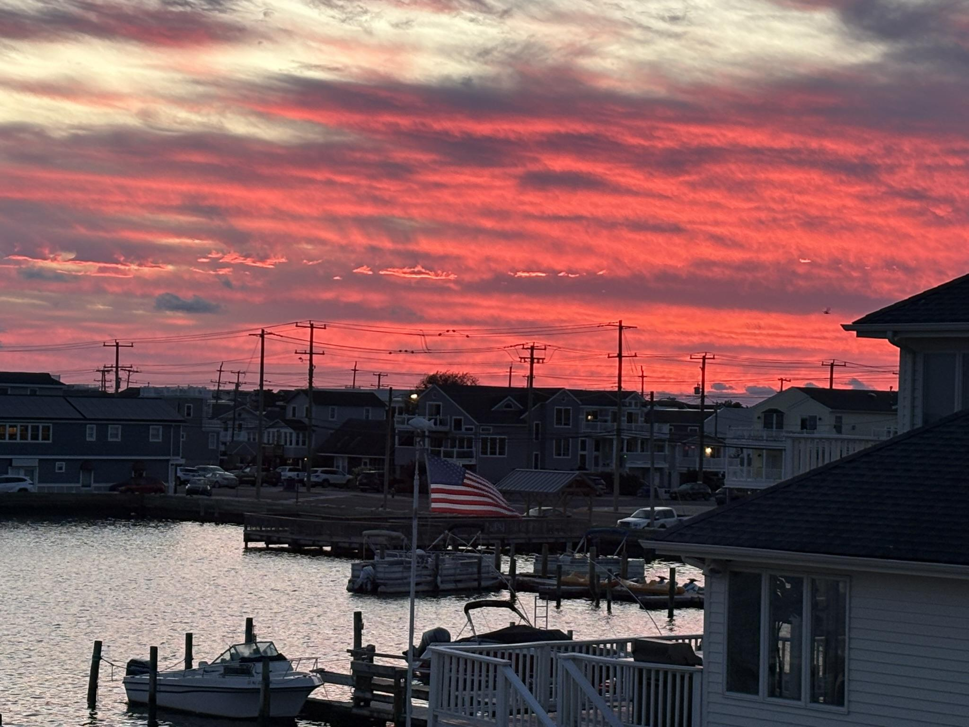
Course goals and objectives:
Students will be exposed to four main conceptual themes throughout this course:
Exploring biological concepts and making connections to real-life situations.
Planning a research study/investigation in order to collect and display valid information on a poster.
Recognize and use the scientific method.
Becoming aware of techniques for collecting and identifying local marine species.
Students will meet the standards referenced in the scope and sequence guide from the New Jersey Core Content Standards.
Students will follow all cell phone and electronic devices policies as set forth by the school.

Slide 5
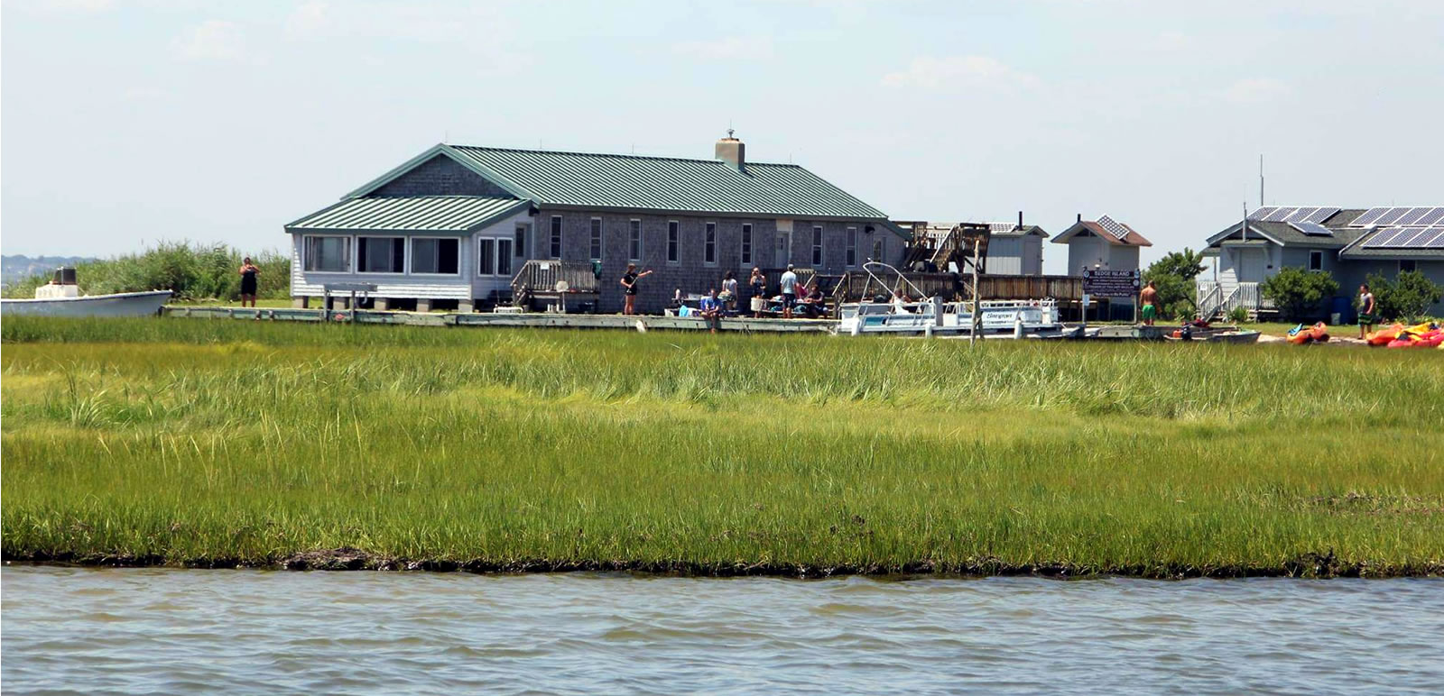
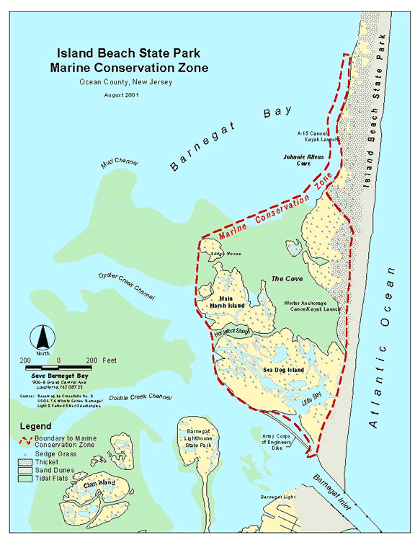
Field Trips!!
Field Trips during your Block
  80 minutes - back for next class)
  Usually once a week
  Schedule is given but can change!
  Always have a change of clothes in your locker
Sedge Island Day Trip - one day in September. Details in other slides

Slide 6
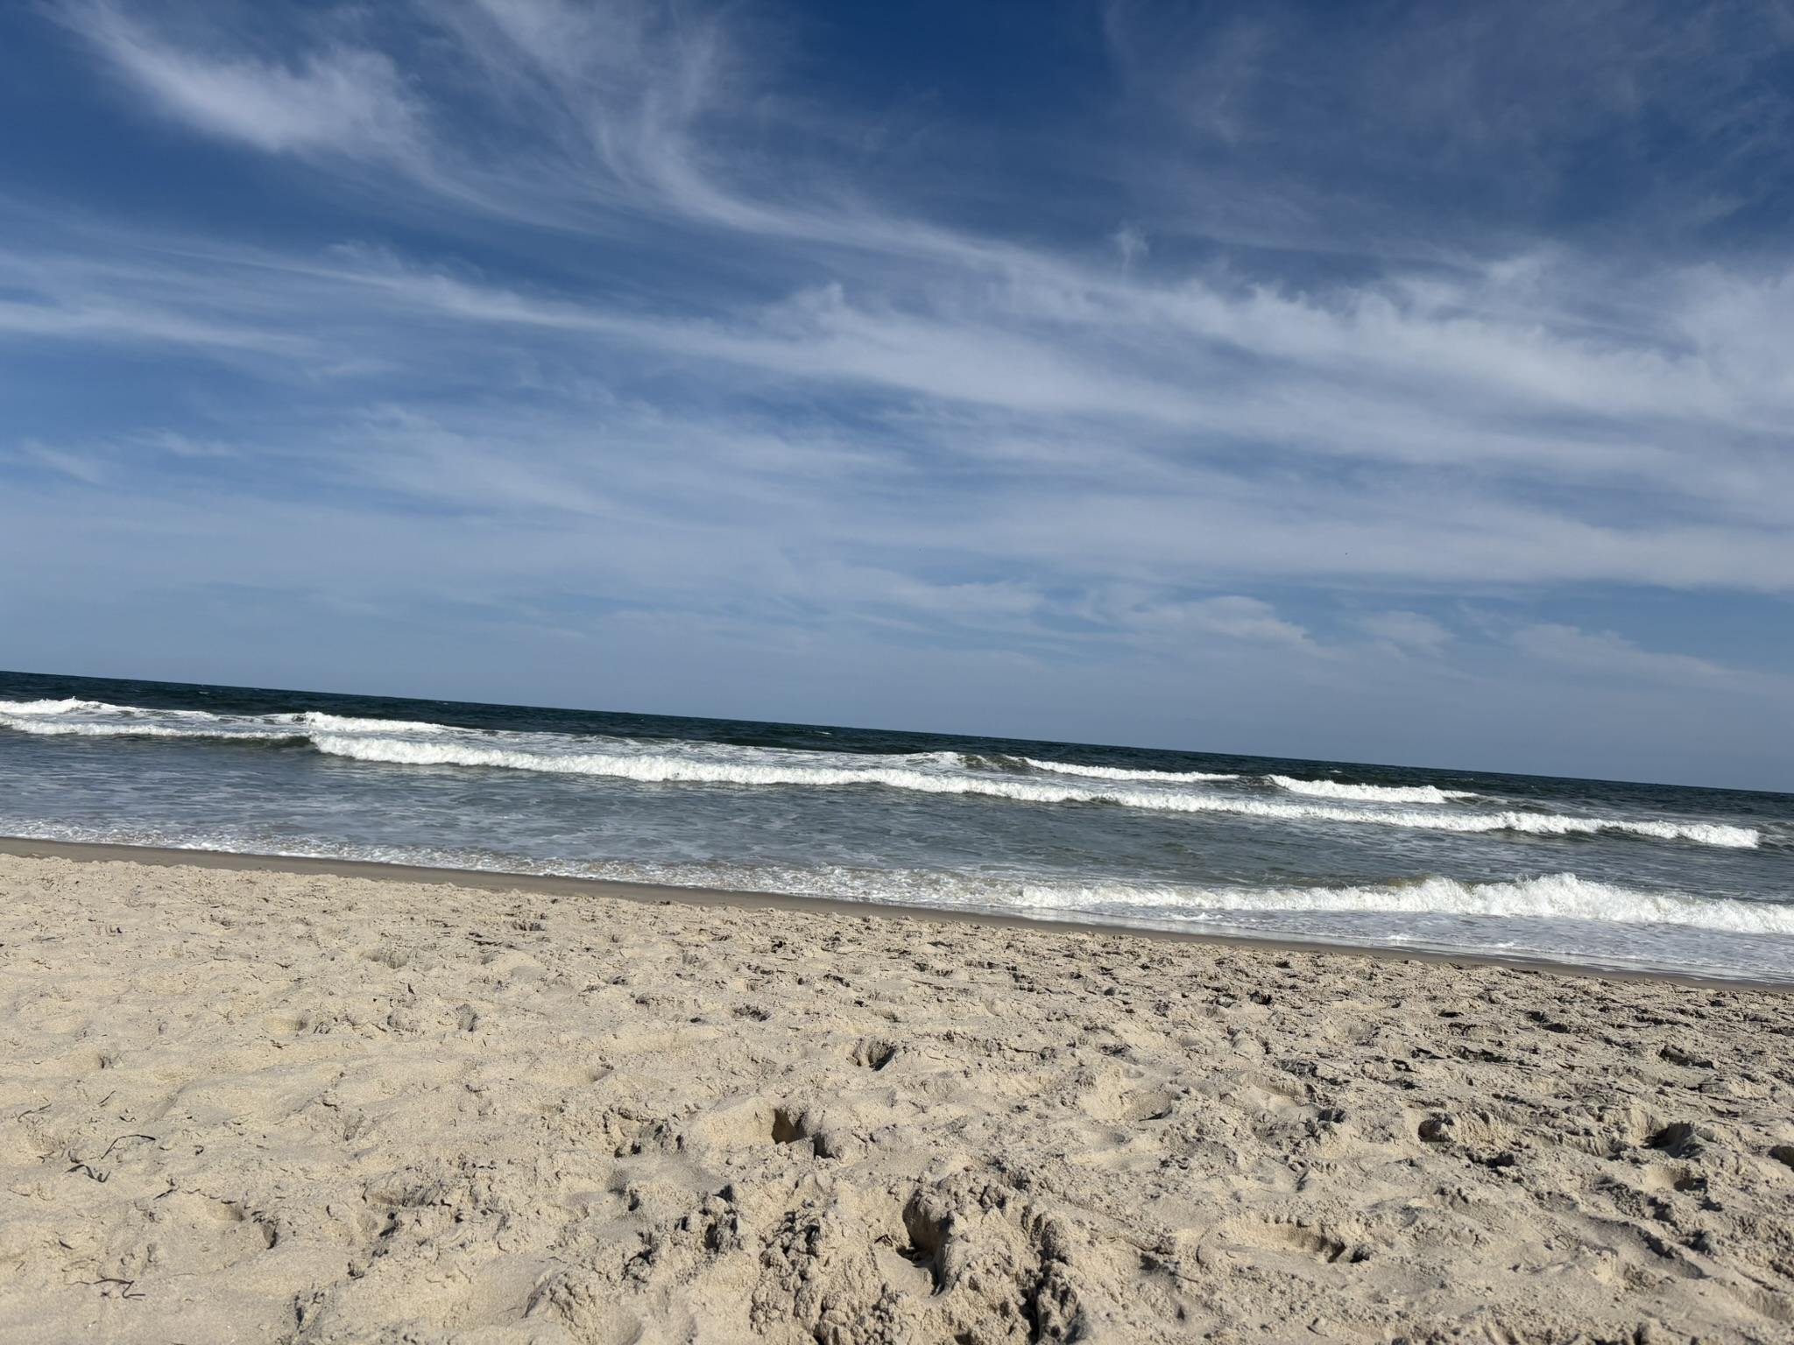
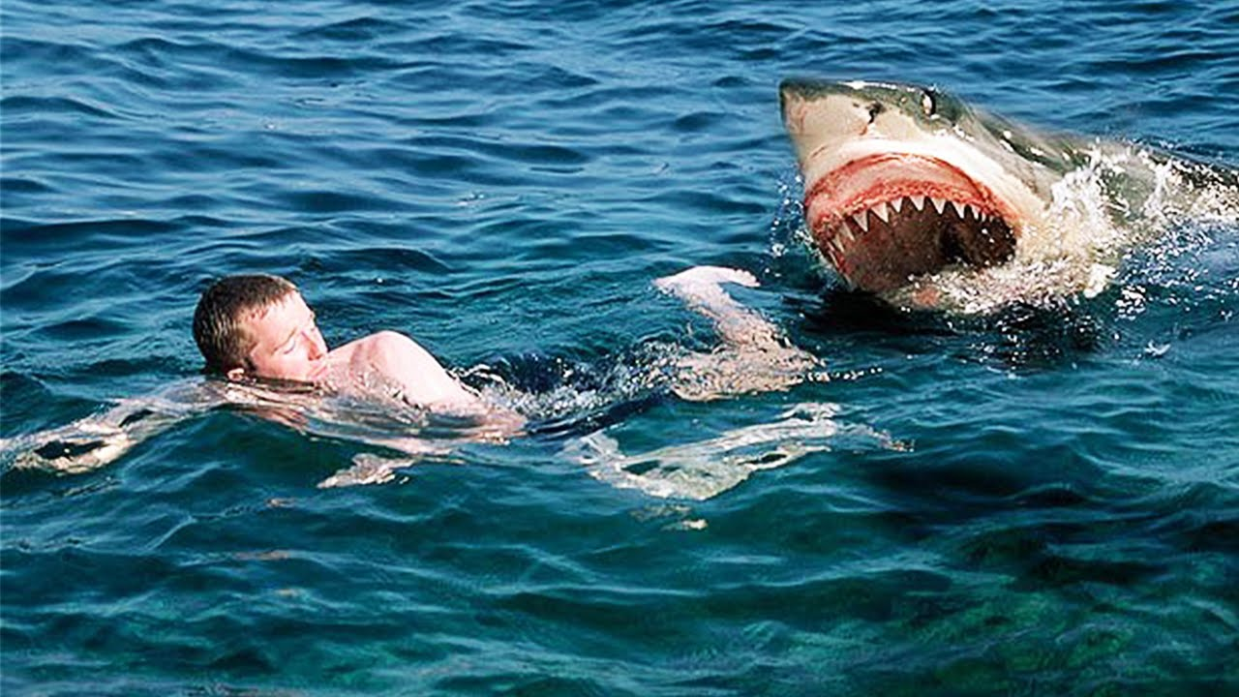

SAFETY!!!!!!
Comply with School Dress Code
Closed Toed/Backed Shoes
Follow Directions
Be Careful with Glass
Clean up after yourself
Be Tidy
Wash hands
Report any breakage
Eye Wash/Shower Stations
Safety Goggles and Gloves provided and worn when directed

Slide 7
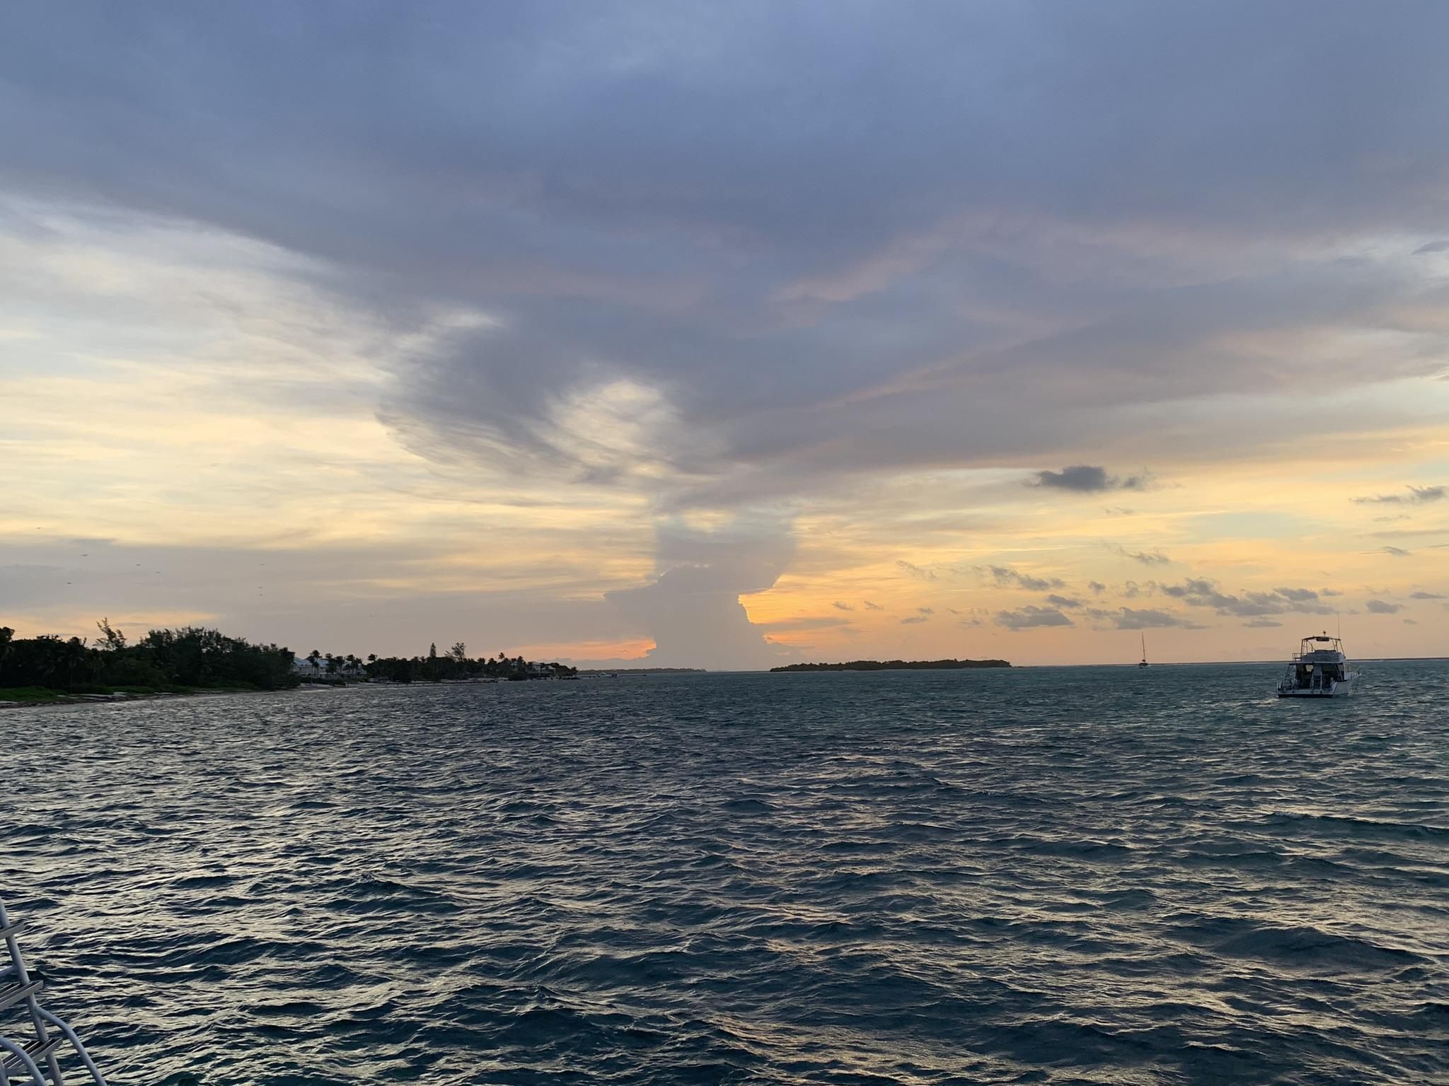
Classroom Materials List:
Notebook OR 3 ring binder with Lined paper (should have folders within or use a separate folder)
Pen and/or Pencil
"Field" Journal - journal style notebook with a hard cover
150 notecards (3X5, 4X6 or 5X8)
Field Materials List:
Water Shoes/Field Boots
Rain Gear/Warm Weather Gear
Sunscreen
Water
Specifics will be covered before each field day
First Year Research Materials List:
“Project" Journal - physical journal to keep track of your progress
Materials specific to your project that are available within reason from stores (examples: plastic bags, containers, seeds, flower pots, etc)
Double Sided Tape - very helpful with putting together your poster
Matting Paper - if you want a specific color that we run out
Other Suggested Supplies:
Organizing Tabs/Sticky notes for journal
Double Sided Tape
Scissors
Colored pencils
Highlighters

Slide 8
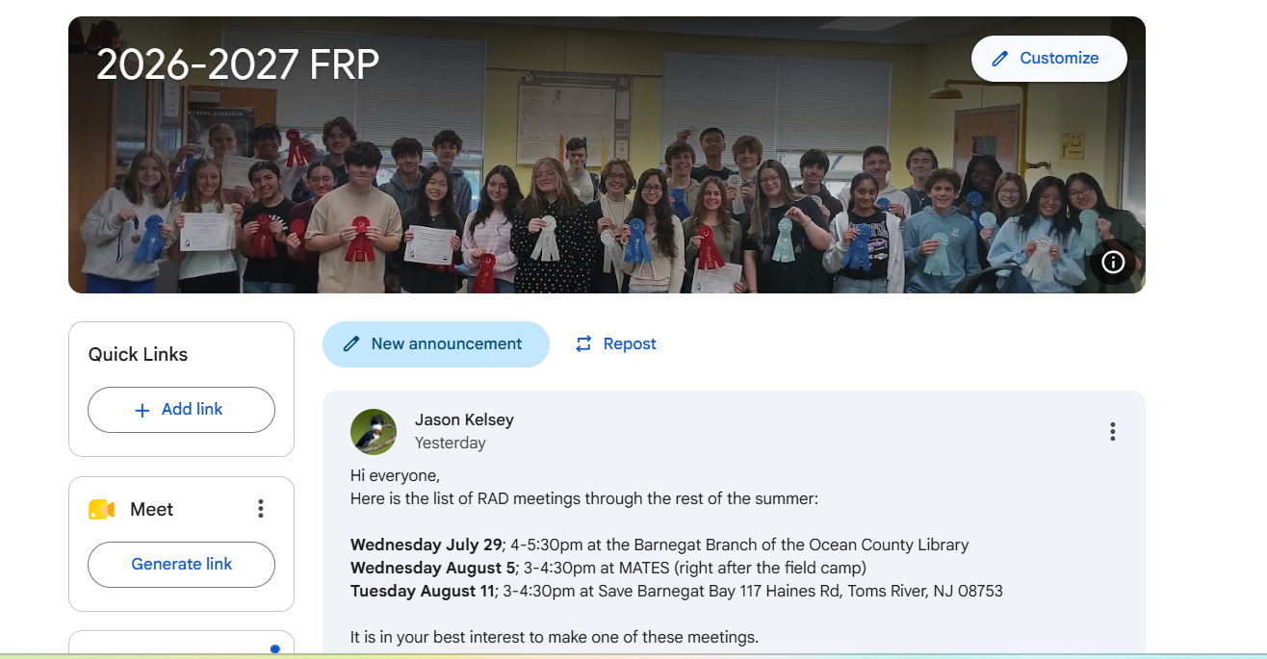
First Year Research Project
All work, announcements and other important information will be posted in the First Year Research (FRP) classroom. Grades will get transferred to the biology course. Here are some resources (MATES Research)

